Slide 1
Final Capstone Presentation:
Research Funding Gap Analysis for Program (RF-GAP)
Amanda DiBattista, Ph.D.
Health Specialist
Division of Neuroscience
National Institute on Aging
July 31, 2018

Slide 2





Problem
At NIH, we track the research we fund to make decisions everyday …
… But, what are we missing?
Grants
Funding
Research Articles
Outcomes
“To carry out this mission, NIH supports a balanced research portfolio to ensure high return on investment for U.S. taxpayers”
Source: www.nih.gov/about-nih/what-we-do

Slide 3
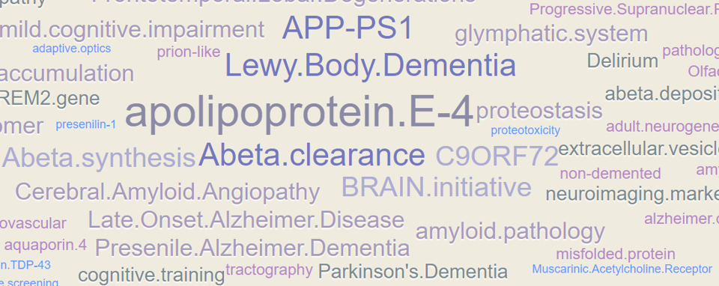
Methodology
Research Articles
Grants
Clustering via k-means
Research Articles
Grants
Funding
Gaps
Publication
Gaps
No Gaps

Slide 4
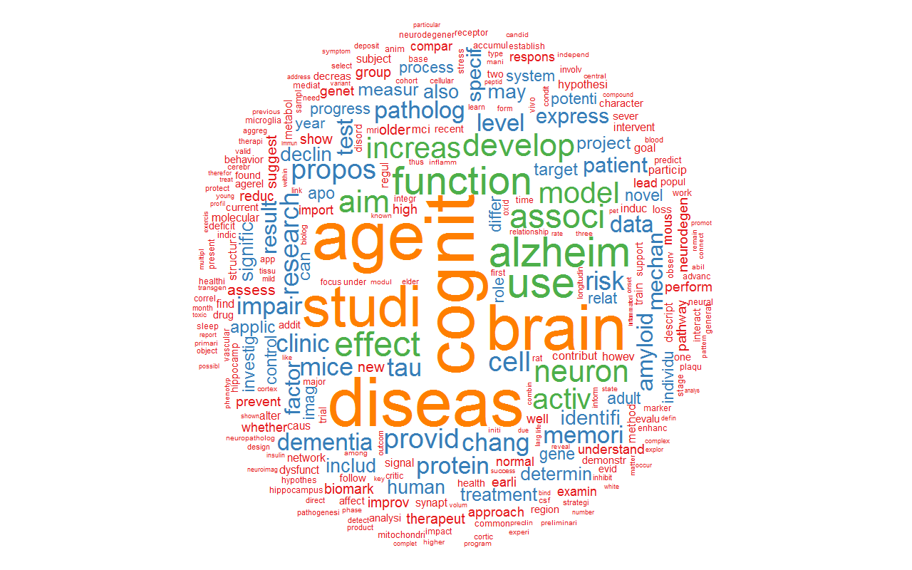
Preliminary Findings
Topic:
Brain Aging
1772
Grants, NIA
3369
Total
Documents
1597
Research Articles
NIH & Non-NIH

Slide 5
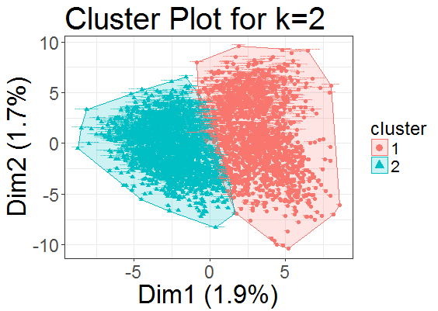
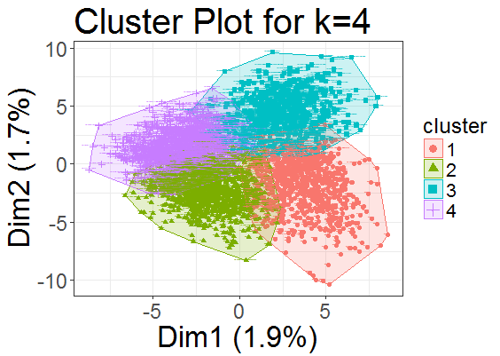
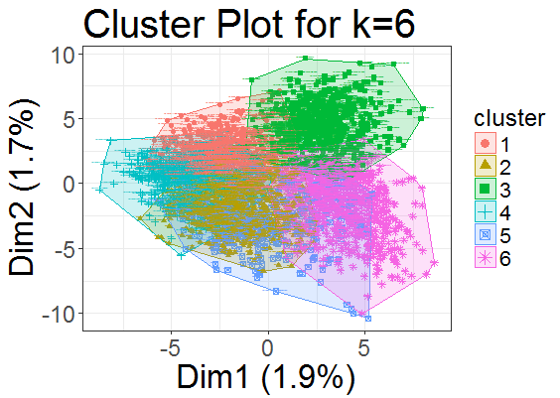
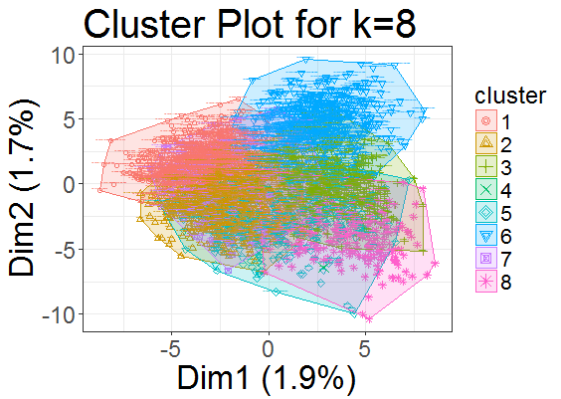

Slide 6
Results & Next Steps
Funding Gaps
92%
85%
Grants
90%
Research Articles
95%
83% are not funded by NIH
?

